Slide 1
Analysis of Auto-Mpg
EDA Project
Venkata Sai Suneeth Ravilla
Bowling Green State University

Slide 2
Objective of Analysing Data Set
The purpose of analysing this dataset is to obtain useful and usable information of predictor variable
Factors affecting mpg
Identifying relationship between variables
Detecting outliers within the variables
Distribution patterns of numerical variables using Histogram
Analysis of categorical variables using boxplot
Correlation between variables
Residual Plot analysis
Symmetric analysis using Hinkley statistical method

Slide 3
Introduction of Data Set
According to data scientist Ross Quinlan “the data concerns city-cycle fuel consumption in miles per gallon, to be predicted in terms of 3 multivalued discrete and 5 continuous attributes. ” (Quinlan, 1993)
Number of Instances: 398
Number of Attributes: 9
Mpg is the target variable
5 continuous variables: mpg, displacement, horsepower, weight, acceleration
3 multivalued discrete variables: cylinders and model_year, origin
1 categorical variable: car name
Except for name of car variable all the remaining variables are numeric.

Slide 4
Attributes Information
Mpg – MPG stands for Miles Per Gallon
Cylinders – Engine with more cylinders produces more power, while an engine with fewer cylinders produces less power.
Displacement – The higher an engine's displacement the more power it can create, while the lower the displacement the less power.
Horsepower – If you want to go fast, you need more horsepower.
Weight – Weight of a vehicle along with passengers.
Acceleration – Amount of time car takes to reach a velocity of 60 miles per hour when the initial velocity is zero.
Model Year – The version of a model which has been produced over multiple years from 1970 to 1982
Origin – 1 make in America, 2 in Europe and 3 in Japan
Car Name – Name of the car when released into the market

Slide 5
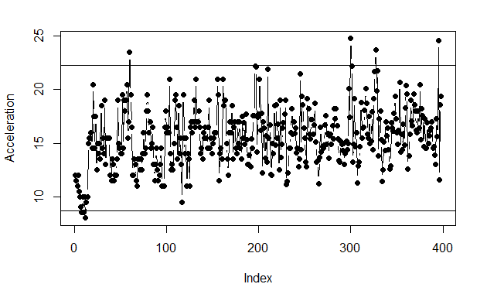
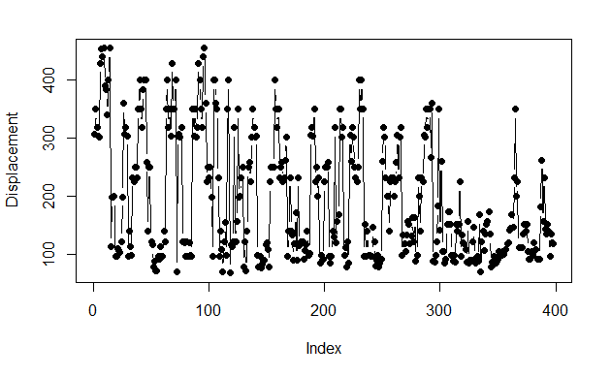
Outliers
For Acceleration, the minimum value is 8 and the maximum value is 24.8, but on average it is 15.5 with a variation of 7.6. From the 1st graph, we can see there are outliers.
Most of the points fall between 12.5 to 20 by which we can say that variance of acceleration is low.
Lower fence = 8.7
Upper fence = 22.3
From 2nd graph, we can see there are no outliers for Displacement variable.
Lower fence = -133
Upper fence = 499
Here we can see most of the data falls around 100 and only a few above 400, by which we can assume that graph will be right skewed.

Slide 6
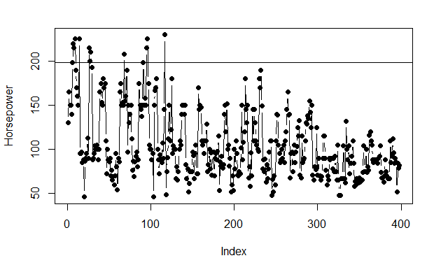
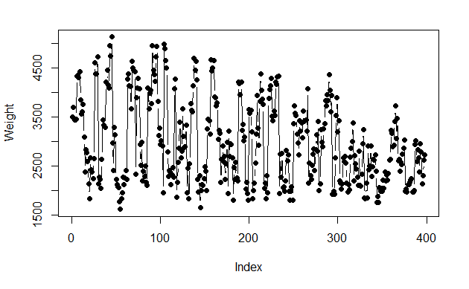
Outliers
Horsepower also has outliers, but it does not seem to be an extreme outlier as 10 points lie just above the upper fence.
Lower Fence = 2.5
Upper fence = 198.5
Most of the points fall in the range 100 which shows that more than ¾ of the cars are having the same horsepower which can also be assumed as right skewed.
Weight does not have any outliers.
Lower fence = 144
Upper fence = 5688
The graph does not show any pattern, as we can see weights are distributed all over from 1500 to 5000.

Slide 7
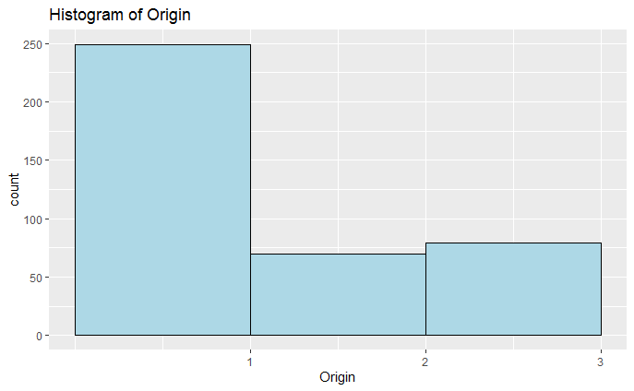
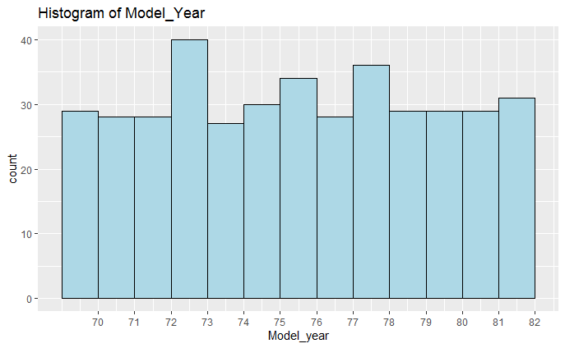
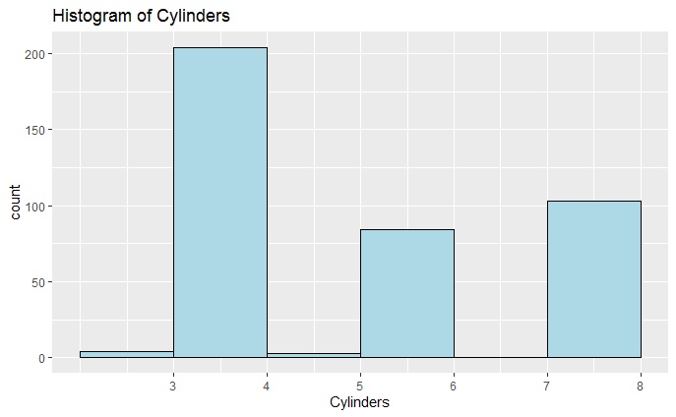
Histogram
From origin graph, we can say that during this period the USA has manufactured more number of models. Therefore the frequency for region 1 is extremely high than the other two regions.
Interestingly, the number of models released through out the years remained almost constant, which is around 30.
Out of all the years, 1973 has more count of 40
When we analyse cylinders, we can see that frequency of cylinders with even number is high which shows that almost all the models are built using a pair of cylinders either 2, 4 or 8.
Out of all the cylinders, 4 cylinders models are higher with a count of 201.

Slide 8
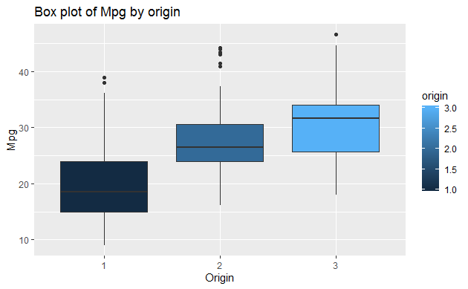
Parallel box plot (Origin vs Mpg)
Out of 3 origins, Japan has the highest average value of mpg with 31 which is also higher than the upper quartile mpg of USA and Europe countries.
The average mpg of USA is very low when compared with other two countries, this might be due to their latest innovation in technology which tend them to focus on speed of the car.
All the 3 Origins has outliers and Japan is holding highest mpg value of 46.6

Slide 9
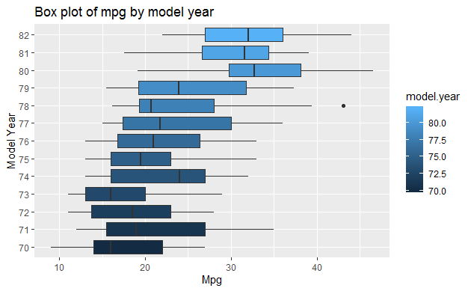
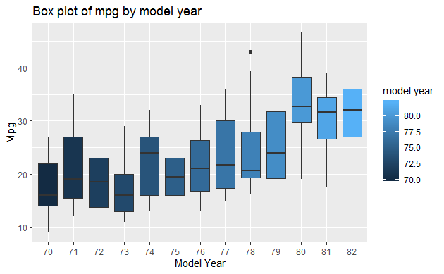
Parallel box plot (Model Year vs Mpg)
The box plot shows as the years progressed, the general trend of mpg values has been increased.
The highest average value of mpg is 32.5 in the year 1980.
Lowest average mpg value is 16 in the year 1970.
By analysing this plot we can estimate that due to the time factor in early 70’s there were no experts to focus on mpg and later on with improved engineering they might have considered mpg as an important factor due to gasoline and climate effects constraints.

Slide 10
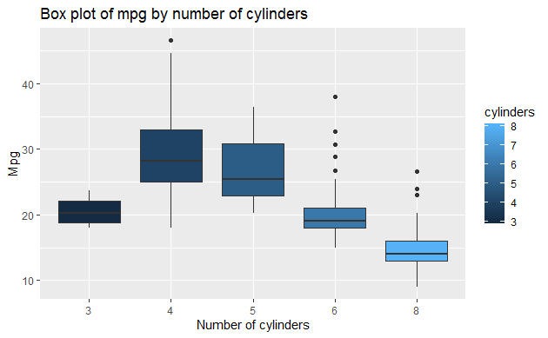
Parallel box plot (Cylinders vs Mpg)
The general trend of mpg shows that as the number of cylinders increased mpg has decreased.
We can expect a right skewed distribution graph.
Highest average mpg was obtained when a car is installed with 4 cylinders.
There is high variance when 4 and 5 cylinders were used. The average mpg is also comparatively high which shows that different factors are implemented to achieve the best performance by choosing cylinders either 4 or 5 as default.

Slide 11
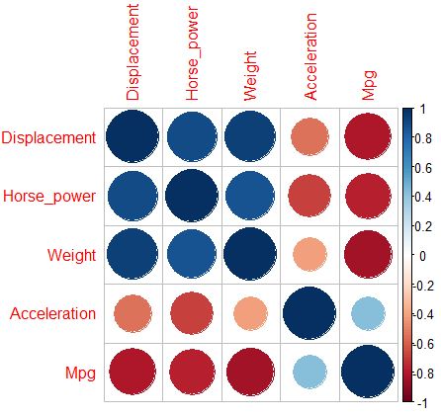
Correlation matrix
The highest correlation among all continuous variables is between weight and displacement with the correlation of 93% which shows that displacement of the car is dependent on the weight which is significantly known that as the weight increases the power required for displacement also increases.
Mpg is positively correlated with only one numerical variable which is Acceleration with 42%.
The highest correlation between mpg and any of the other variable is with weight and it has a negative correlation of 83%. This makes sense, the more a car weighs the more energy is required to move it down the road and the energy is from the gasoline which means mpg is going to be affected.

Slide 12
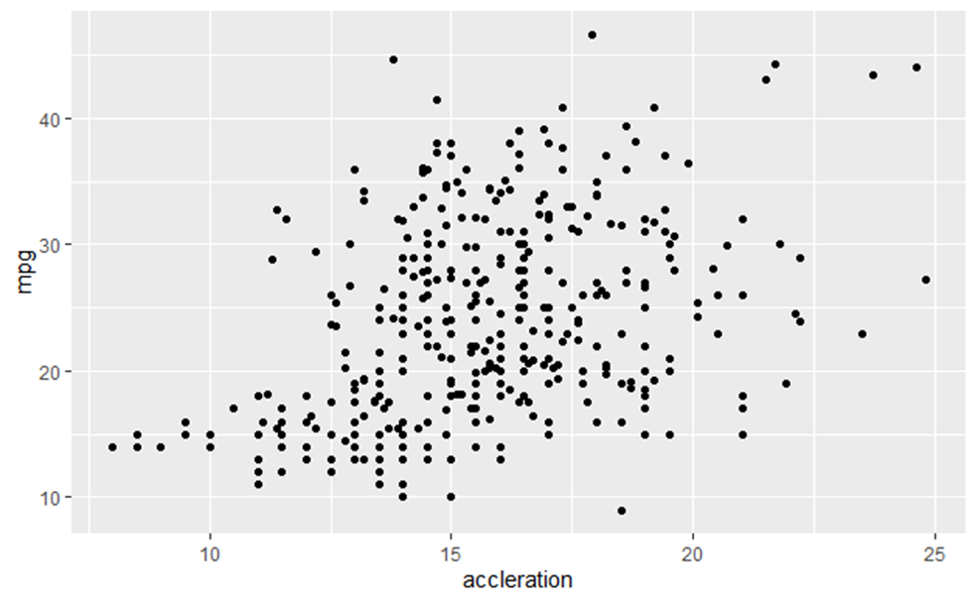
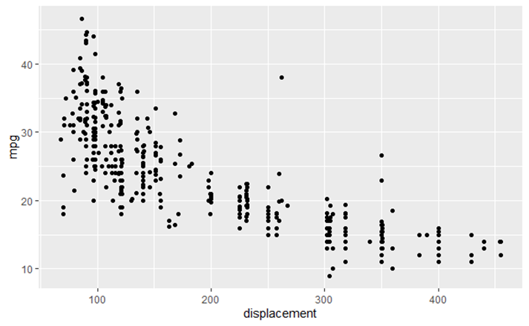
Scatter Plot
Acceleration vs Mpg
There is less correlation between these two variables, the points are scattered all over the graph.
Displacement vs Mpg
The trend between these two variables indicates that as the displacement increased, mpg is decreasing which shows a negative correlation.

Slide 13
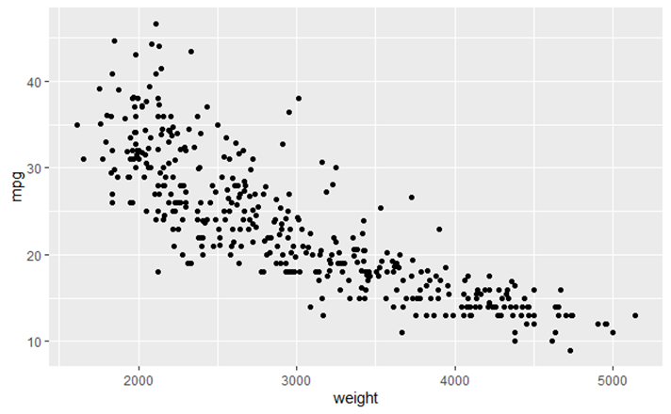
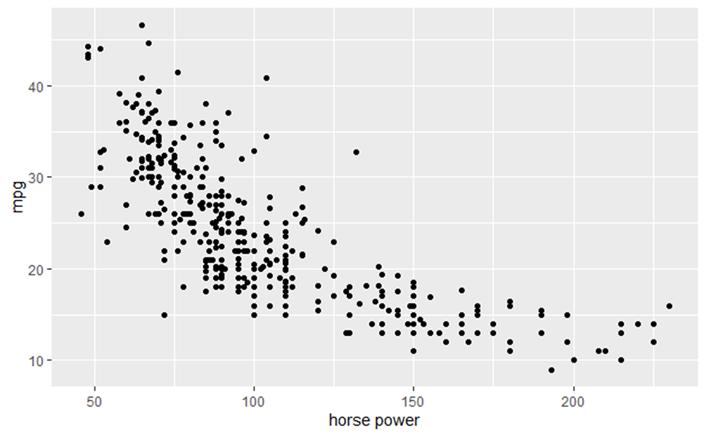
Scatter Plot
Horsepower vs Mpg
Horsepower is also effecting mpg in a negative way, as the horsepower increases mpg gradually decreases
Weight vs Mpg
As the weight increases mpg of the car is decreasing so in order to increase mpg, the weight of the car should be considered.

Slide 14
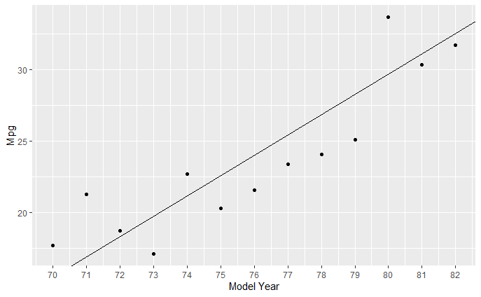
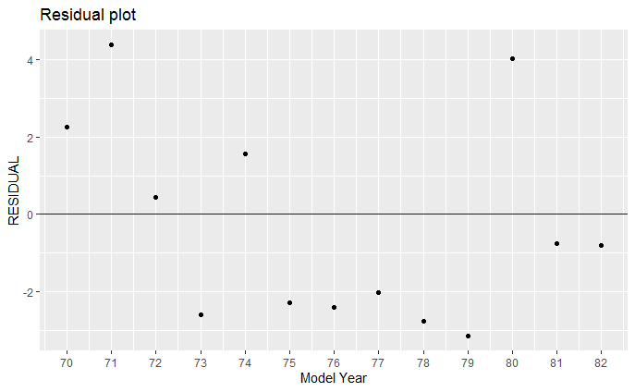
Residual Plot (Model Year vs Mpg)
The slope of the line is 1.4 which means that, for the years 70 to 82, the mpg of cars has been increasing about 1.4 miles per gallon per year.
mpg = 23.975 + 1.424(model.year-76)
Residuals in the graph look constant, there is a large value of mpg in 71 which means that mpg is higher than what is predicted using a linear model.
The residual in the year 79 is smaller than all the residuals but it does not have much variation when compared with the previous 4 years.
By analysing residual, we can see a strange difference in mpg between year 79 lowest and 80 which is almost high, this can be assumed that due to the increase in fuel price or the availability in fuel made manufacturers consider mpg as major factor in the year 1980 which encouraged them to make better fuel economy cars.

Slide 15
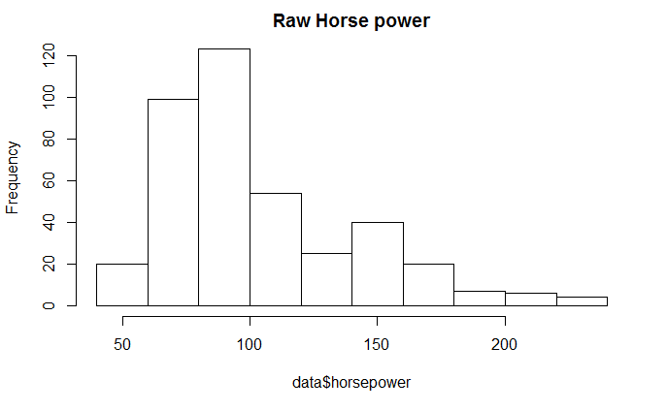


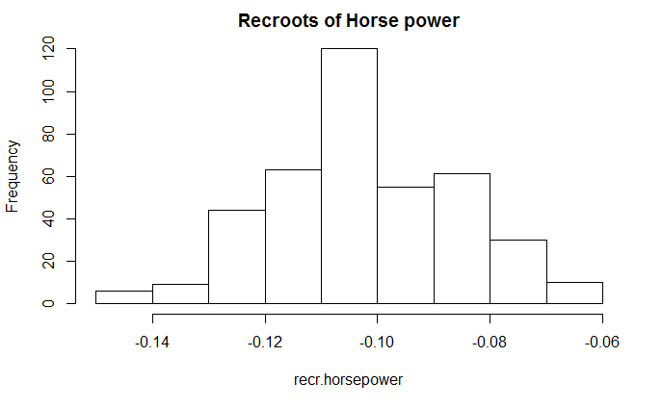
Skewed to Symmetric
Among all the continuous numerical variables Horsepower has a high skewed distribution.
We can analyse the skewness in distribution using Hinkley’s statistic method.
From Hinkley’s statistical method we can see that Reciprocal roots has the smallest d value which is nearly equal to zero.
d value of reciprocal roots = 0.013
After applying reciprocal roots function to horsepower we can see a normally distributed output which justifies our approach using Hinkley’s statistic method.
Therefore a normalized horsepower values would give us a better understanding of the data.

Slide 16
Conclusion
Outlier analysis of numeric predictor continuous variables we saw that acceleration and horsepower have outliers whereas weight and displacement does not. For a better analysation of data, we have to take care of outliers by either replacing them with mean, median or mode of the respective variable.
Frequency analysis of multivalued discrete variables shows that most of the models use 4 cylinders and the USA produced more number of models than any other country.
Box plot analysis of multivalued discrete variables w.r.t mpg depicts that even though USA has produced more number of models, Japan has succeeded in producing better fuel-efficient models. Average Mpg of the models released has increased over the years in all the countries. The models with 4 cylinders tend to achieve better fuel economy.
In correlation matrix we saw that all the numeric continuous variables are negatively correlated with the target variable mpg except acceleration.
In scatterplot analysis of numerical variables with respective Mpg, we can see that weight, displacement and horsepower are constantly effecting Mpg negatively.
By analysing the residual plot between the model year and mpg, there is a constant increase in mpg value by 1.4 times per year.
Normalization of the variable can be achieved using different functions in Hinkley's statistical method. In this dataset right skewed distributed values of horsepower variable are normalized using reciprocal roots function.
Finally, in order to choose a fuel-efficient model one has to select a latest vehicle manufactured by Japan with 4 cylinders having low displacement, weight and horsepower.

Slide 17
Source
https://archive.ics.uci.edu/ml/datasets/auto+mpg
This dataset was taken from the StatLib library which is maintained at Carnegie Mellon University. The dataset was used in the 1983 American Statistical Association Exposition

